Slide 1

Student Teaching
Mentor Training
Module
The University of Akron
LeBron James Family Foundation
School of Education
330-972-7961

Slide 2

What is covered in this training
Getting Started - Website and materials you will need
Evaluation materials
Co-Teaching Model
edTPA
Questions/Problem Solving

Slide 3
Part 1 of 5:
Getting Started

Slide 4
Student Teaching Website
Go to www.uakron.edu
In the search box type in Student Teaching and click Enter
Then click on the Mentor Teacher link
OR click the link below
http://www.uakron.edu/education/current-students/student-teaching/index.dot

Slide 5
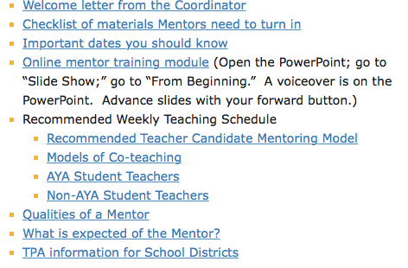
Website Information

Slide 6
What is expected of a mentor teacher?
Welcome the teacher candidate to your school. Introduce him or her to your students, other faculty members, and support staff. Give student a tour of the classroom and school. Explain school policies and procedures regarding such things as signing in and out of the building, the time they are expected to report to school, the time their day ends, computer use, use of copy room services, etc.
Discuss daily schedules, routines, and duties. Share your teaching responsibilities with the teacher candidate, exchange personal phone numbers and e-mail addresses. Discuss appropriate dress code, attendance, and professional behavior in and out of school.
(Continued, please move forward as the narration continues)

Slide 7
What is expected of a mentor teacher?
Provide dates and times of other teaching responsibilities (Open House, faculty meetings, department/grade level meetings, parent/teacher conferences.) These are expectations of the student teaching experience.
Work with the teacher candidate to determine a schedule for assuming teaching responsibilities.
Provide the student with the course of study objectives (standards, pacing guide, etc.), textbooks and resources that relate to the content he/she will be teaching.
(continued)

Slide 8
What is expected of a mentor teacher?
Support the teacher candidate in developing skills in planning, instruction, assessment, and classroom management. Share your own experiences, ideas, beliefs, and management procedures to help the teacher candidateto gain classroom confidence.
Encourage your teacher candidate to reflect on each lesson to gain further insights from his/her successes and challenges.
Set up a specific time/day you would like to review lesson plans. Make sure this gives the teacher candidate ample time to modify accordingly.
(continued)

Slide 9
What is expected of a mentor teacher?
Communicate regularly with the university supervisor. It is of benefit to the teacher candidate when the whole team is in regular communication.
Collaborate with the University Supervisor on a midterm and final evaluation.

Slide 10
Website Information
Forms
Personal Data Form (Form on our website that our mentor teachers submit for our accreditation agency.)
Lesson plans (Form our teacher candidates use for writing their lesson plans)
Survey by Mentor Teacher (Form on our website done at the end of the semester which evaluates our office and the University Supervisor)

Slide 11
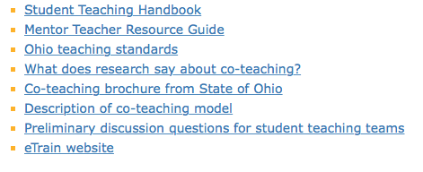
Website Information
Resources

Slide 12

Source: The Mentor Teacher Resource Guide

Slide 13
What do you think teacher candidates struggle with the most?
Classroom management
Teaching concepts in the content area – using current research in methodologies and using the content language

Slide 14
Beginning Conversations
Focus on:
Classroom rules - How are they developed?
Classroom routines - How do they affect behavior management?
Student participation - How do you engage a student? How does this impact behavior management?
Teacher expectations – Making them clear and concise. How can that impact behavior management?

Slide 15
Instructional Methodologies
Focus on instructional methodologies when giving feedback from observations, planning for instruction and or throughout your conversations.
Use the academic content language throughout your conversations as well.

Slide 16
Consider instructional methods that promote student involvement
Brainstorming; bulletin boards; buzz session; case study; coaching; collaborative learning; chunking or clustering; committee work; community-based research; community-based service projects; computer-assisted; concept mapping/webbing; debate; demonstration; discovery; discussions (Socratic seminar, fishbowls, panels, roundtables, inquiry discussion groups); distance learning; drama; drill; expository writing; field trip; forum games; group work (cooperative learning groups;) dyads; homo- or heterogeneous grouping, inquiry grouping; tutorial grouping; guest speaker independent work stations; individualized instruction; inferring; inquiry learning; guided inductive inquiry; interviews; jury trial; K-W-L; laboratory investigation; learning activity center; direct-learning center; open-learning center; skill center; library/resource center; metacognition; mock-up; mock-trial; multimedia creations; outlining; paraphrasing; periodicals; presentations; problem solving; problem-based learning; project; questioning; reciprocal teaching; recitation; review and practice; role play self-instructional module; simulation; sociodrama; study guide; study strategies; summarizing; survey projects; symposium telecommunication; research paper/presentation/web-quest/annotated bibliography; think aloud; think-pair-share; Vee mapping; Venn diagramming; visual learning logs, visual tools; webbing/concept mapping; writing pals/pen pals; writing across the curriculum

Slide 17
Part 2 of 5:
New Evaluation Forms

Slide 18
Evaluation Forms
The new UA Teacher Candidate observation, midterm and final evaluation forms are in alignment with OSTP (Ohio Standards for the Teaching Profession.) There are elements included in the student teaching evaluations that are pulled from the OTES Evaluation.

Slide 19
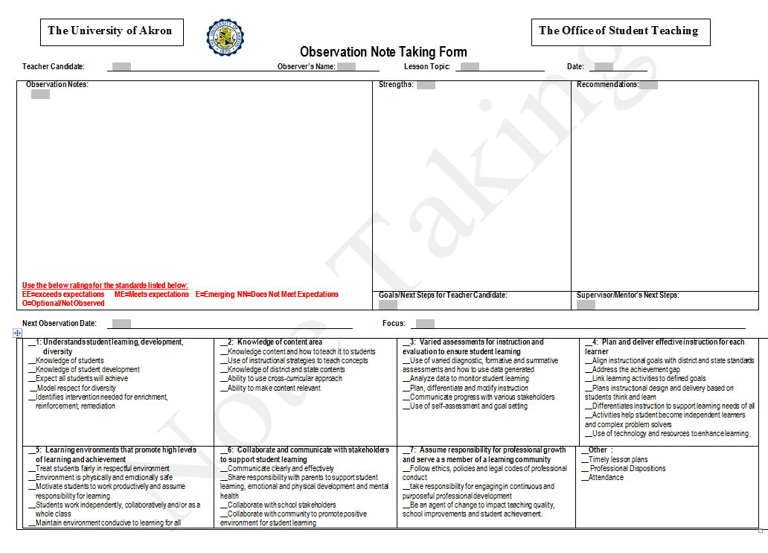

Slide 20
Evaluation Forms
You will use three different evaluation forms:
Observation form (optional for the mentor teacher to use when doing an observation on your teacher candidate). Form is found on our website. There is a Note Taking form you can use while observing. If you choose to use these forms, please forward to the University Supervisor.
Midterm and Final evaluation worksheets (The University Supervisor will provide this to you in advance of the evaluation meeting. You will share your ratings in a conference with the teacher candidate and the University Supervisor)

Slide 21
Midterm and Final Evaluations
In the Midterm and Final evaluations you will find various sections which include
  Planning
  Engaging students in learning
  Assessments
  Dispositions
  Like OTES, you would indicate evidence/rationale that the teacher candidate has either exceeded, met, is emerging, or does not meet expectations.

Slide 22
Part 3 of 5:
The Co-Teaching Model

Slide 24
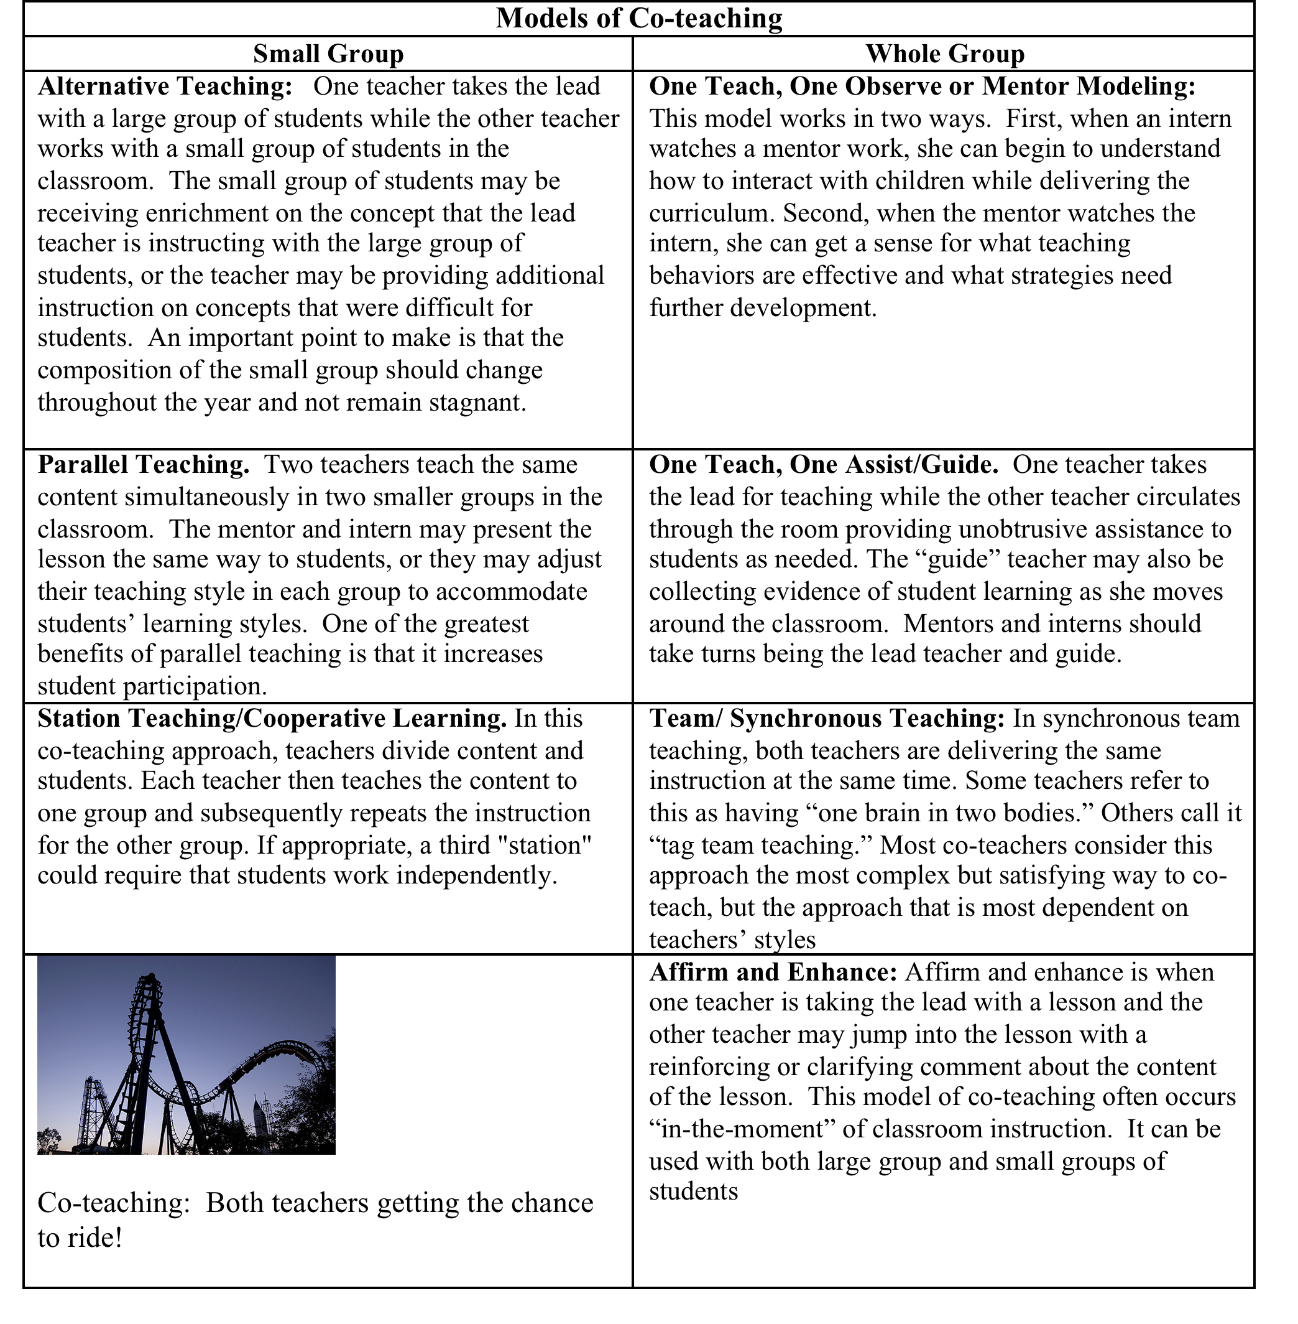

Slide 25
Part 4 of 5:
edTPA
(Teacher Performance Assessment)

Slide 26
edTPA
ODE has now required all teacher candidates to complete the edTPA portfolio which includes submission of a video recording of the teacher candidate teaching students the featured lessons. Confidentiality agreements are signed by the teacher candidates expressing that they not share the videos under any circumstance except for submission to Pearson.
The University of Akron’s teacher candidates submit their edTPA for national scoring by Pearson.
Mentor teachers are asked to provide support by offering feedback on the teacher candidate’s lesson plans, implementation of the lesson, and assessment of student learning.

Slide 27
edTPA Process for Teacher Candidates
Create a Content-Specific Teacher Work Sample that includes:
Task 1 - Planning Instruction and Assessment
Task 2 - Instructing & Engaging Students in Learning (includes video taped segments)
Task 3 - Assessing Student Learning
Use of Academic Content Language is embedded in each task.

Slide 28
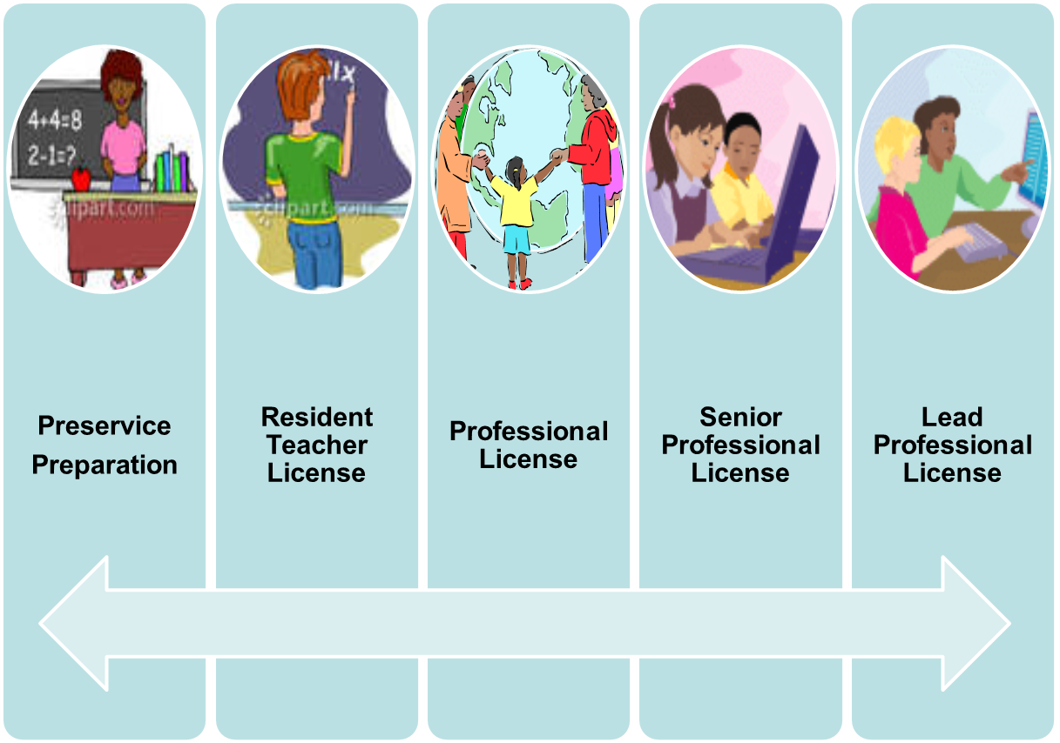

Pre-service through Lead Teaching
edTPA OTES OTES OTES OTES
RESA National
Board

Slide 29
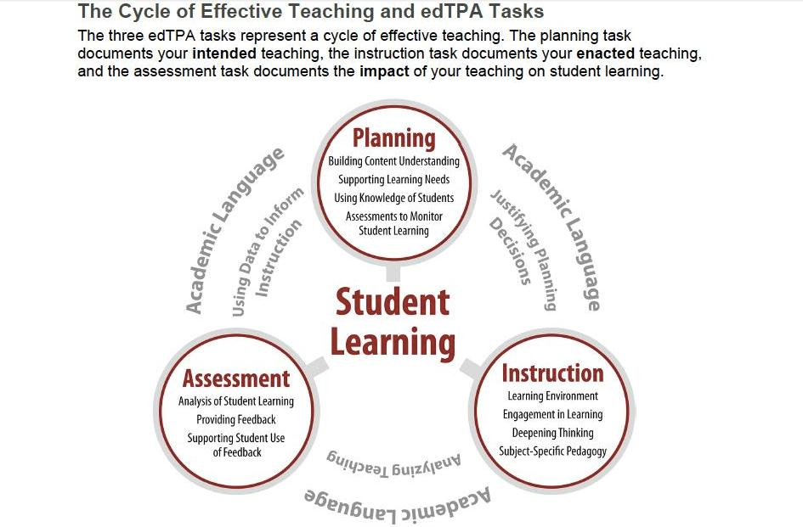

Slide 30
Role of the University Supervisor
The University Supervisor is employed by the University to supervise and evaluate the work of the teacher candidate at regular intervals during the period for which the student is assigned as well as be the liaison between the classroom setting and the university.
The supervisor will determine whether additional assistance is needed and seek out that assistance. The principal responsibility of the university supervisor is to assist the teacher candidate in developing teaching competencies.
During the semester the University Supervisor is to visit the teacher candidate a minimum of eight times. This would include the introductory meeting and facilitating the final exam. They are required to complete four to five formal observations in which they observe the candidate for a minimum of 30 minutes. They are then responsible for providing the Teacher Candidate with a written evaluation of their observation.

Slide 31

Part 5 of 5:
Burning Questions
Please send any questions to:
Dr. Marty Saternow
mes93@uakron.edu
or
Mrs. Sandy Wilkes
swilkes@uakron.edu

Slide 32
Problems?
If there is a problem or issue, contact the University Supervisor first.
If the problem persists, you should then contact 330-972-7961

Slide 33
Thank you!
The University of Akron’s
College of Education
and
Office of Student Teaching and Field Experience
thank you for “paying it forward” to the profession.
Without excellent mentors, we would not be able to provide excellent experiences for our teacher candidates!

